Slide 1

(S-1) VIDEO
STEGANOGRAPHY (.MP4)
Clint Bhola & Mossa Hana
ITMS-X48
2 – Semester Project

Slide 2
Deliverables
Understand the structure of .mp4 files and being able to identify how covert files can be hidden in them.
Working with some steganography tools used for hiding data in carrier files.
Develop a software tool to detect whether .mp4 file has covert information hidden in it.

Slide 3

MP4 STEGANOGRAPHY
Many devices, used for capturing video, can manipulate the video using the MPEG-4 standard (movie- cameras, cameras, mobile phones). Due to the high resolution in this standard, we decided to design and implement a steganographic system, that uses some features of the MPEG-4 encoder.

Slide 4
BIT-STREAMS IN THE MP4 FILES
An MP4 file is a multimedia container for storing various data streams.
The audio and video streams are the most commonly interleaved streams . The container/the MP4 file is specified by the international standard ISO 14496-14.
The format is derived from the QuickTime container, developed by the Apple.

Slide 5
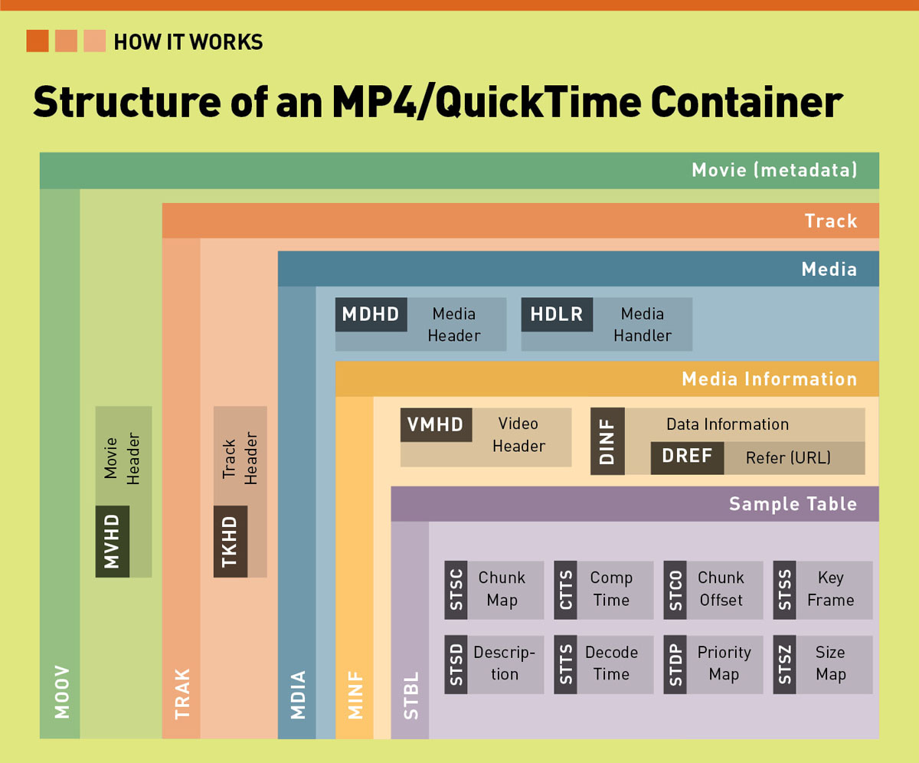
THE MP4 CONTAINER

Slide 6
STEGANOGRAPHY TOOLS
MSUStego
MSU StegoVideo allows hiding any file in a video sequence.
Main features:
Small video distortions after hiding info.
It is possible to extract info after video compression.
Information is protected with passcode.
Unique.

Slide 7
Steganography tools
TCStego
  Hides TrueCrypt Container inside using a python script MP4 container.
WinHex
  WinHex is in its core a universal hexadecimal editor, particularly helpful in the realm of computer forensics, data recovery, low-level data processing, and IT security..

Slide 8
Other Steganography tools
Invisible Secrets (JPEG)
OpenPuff (MP4, BMP, JPEG, PNG)
MP3Stego (Open Source tool for audio)
OpenStego (Open Source tool for images)
MathWorks MathLab
StegoStick (Universal*)
StegSpy (Steg-Analysis) → Hiderman, JPHideandSeek, Masker, JPegX, Invisible Secrets.

Slide 9
OPENPUFF STEGANOGRAPHY TOOL
Steganography, or data hiding software
Freeware for Microsoft Windows (open source and easy to use)
supports a wide range of carrier formats including (MP4)
capable of storing up to 256MB of encrypted data

Slide 10
TRUECRYPT
Create the TrueCrypt Container
Once you have your video file, create a TrueCrypt container. Use the "Hidden Container" option, this generates a container-inside-a-container. Name it 'innocuous-looking-file.mp4' or something similar, and fill out the options regarding the volume size and passwords.

Slide 11
TRUECRYPT (CONT’D)
Merge The Video File And The Container
Now that you have your two files, use the Python script named tcsteg2.py that will now merge these two files together.
Execute:
"python tcsteg.py Movie.mp4 NameOfTrueCryptVolume.mp4“
from a command line to make the merge.
The resulting file is very secure, and hard to detect.

Slide 12
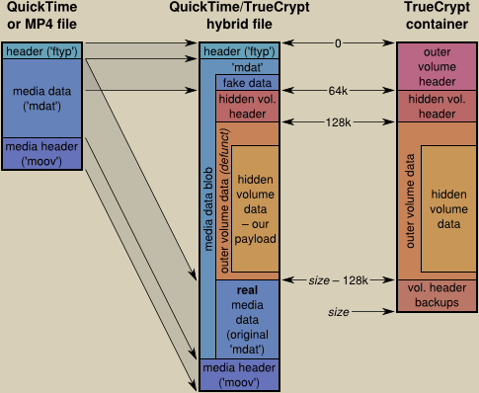
TRUECRYPT

Slide 13
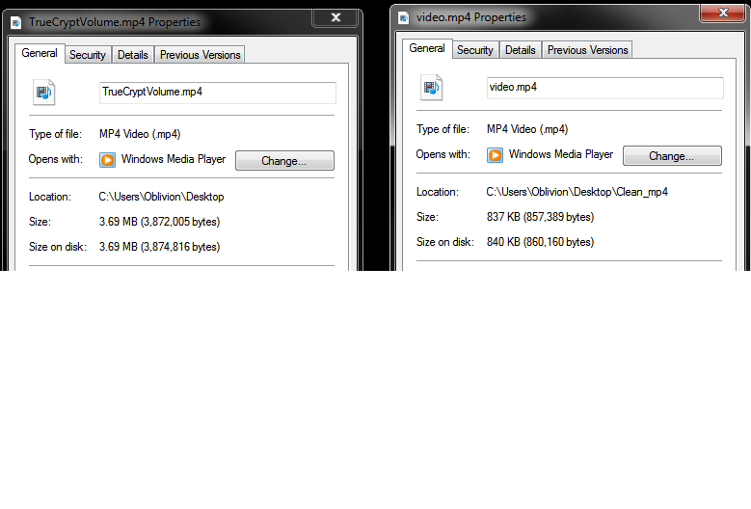
TRUECRYPT - SIZE INCREASE
File increased by 3MB
TrueCrypt .mp4
Original .mp4

Slide 14
Steps
Get a trusted .mp4 clear file.
Use steganography tool; OpenPuff , to encode information in it .
Decode the hidden information from that file.
Analyze the dirty and clean files and compare them.
Develop a tool that can detect dirty files.
Develop that tool so it can encode and decode secret information in and from the carrier file. In addition to its ability to detect the dirty files.

Slide 15
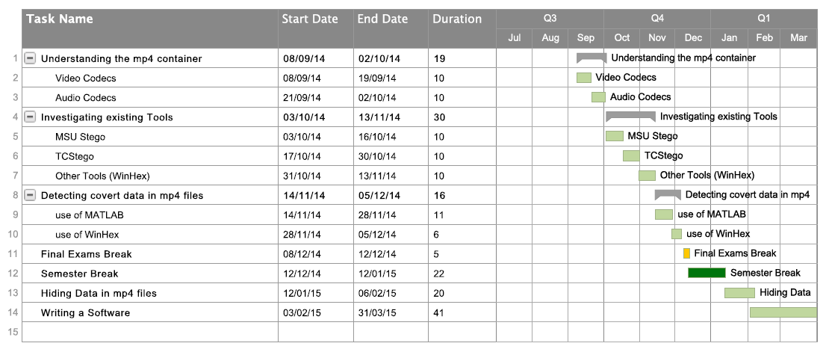
SEMESTER FORECAST

Slide 16
CONCLUSION
TRUECRYPT
Embedding the TrueCrypt volumes within large files will raise no suspicion by end users.
TrueCrypt volumes cannot be detected by hex editors such as WinHex and existing tools such as StegSpy.
Causes an increase in carrier file size.
OPENPUFF
Can be used on most file types.
Does cause a drop in bit rate of the video.
Can hide large files in multiple carry files.
Increase in carrier file size.

Slide 17
REFERENCES
A. P. Sherly, Sapna Sasidharan, Ashji S. Raj, P. P. Amritha. “A Novel Approach for Compressed Video Steganography”
M, Jokay. INTERNATIONAL JOURNAL OF COMPUTERS AND COMMUNICATIONS “The design of a steganographic system based on the internal MP4 file structures”.
Raggo, Michael T. “Data Hiding: Exposing Concealed Data in Multimedia, Operating Systems, Mobile Devices and Network Protocols”, 2013.
Existing Tool Resources
BitLocker. http://windows.microsoft.com/en-us/windows7/products/features/bitlocker
Ciphershed. https://ciphershed.org/
Math-Lab Video Processing. http://www.mathworks.com/image-video-processing/ & http://www.academia.edu/1744320/Introduction_to_Video_Analysis_using_MATLAB
OpenPuff. http://embeddedsw.net/OpenPuff_Steganography_Home.html
TCStego. http://www.dfinews.com/product-releases/2012/01/python-script-detect-hidden-data
TrueCrypt. http://truecrypt.sourceforge.net/

Slide 18
THANK YOU ☺

